Slide 1
PLASTIC SURGERY

Slide 2
Internacional Farmacéutica is a company that for over 45 years has maintained its commitment to innovation and quality, resulting in a product portfolio that integrates medical devices which it manufactures under the Atramat® brand with third party brands from recognized manufacturers worldwide.
Each of our medical device is the result of a rigorous research process in collaboration with health professionals working around the world as well as through commercial alliances with global suppliers of surgical products.
Our dedication to the development products that improve the quality of life drives us to work under strict standards that determine how our medical devices are produced and distributed.
Total control of the production process means we can ensure that all of our products meet the international standards that govern the manufacture of medical devices. To achieve this, our manufacturing and customer support processes are certified by ISO13485, ISO 9001, FDA, ANVISA and CE mark, among others, as a result of which our products are now marketed in more than 80 countries worldwide.
Notes:
Certificaciones internacionales FDA, ANVISA,

Slide 3
In order to ensure that surgeons and nurses have access to the up-to –date information and best practice sharing regarding the choice and use of our products, we have a designed on-line and face-to face educational programs for continuous training.
We invite you to contact us directly or through one of our business partners around the world to obtain personalized information regarding the solutions available for each surgical specialty.
Visit: www.atramat.com

Slide 4
Surgical procedures
Abdominoplasty (abdomen reduction)
Blepharoplasty
Breast augmentation
Breast Pexia
Breast reduction
Rhinoplasty
Otoplasty
Lobuloplasty
Rhytidectomy
Mentoplasty
Brachioplasty
Breast reconstruction
Facial and body plastic surgery
Gynecomastia / Breast reduction in men

Slide 5
 | PGC25 | PGC25 PLUS | PGLA90 | PGLA90 RAPID | PGLA90 PLUS | PDX | PDX PLUS | PGA | PGA RAPID | POLYPROPYLENE | NYLON
Abdominoplasty abdomen reduction)
Blepharoplasty
Breast augmentation
Breast pexia
Breast Reduction
Rhinoplasty
Otoplasty
Lobuloplasty
Rhytidectomy
Mentoplasty
Brachioplasty
Breast reconstruction
Facial and body plastic surgery
Gynecomastia / Breast reduction in men

Slide 6
Atramat® offers specialists in plastic, aesthetic and reconstructive surgery the best results for their patients. Our broad portfolio of sutures for plastic surgery includes absorbable sutures and non-absorbable synthetic materials that reduce the immune response leading to more aesthetic results.

Slide 7
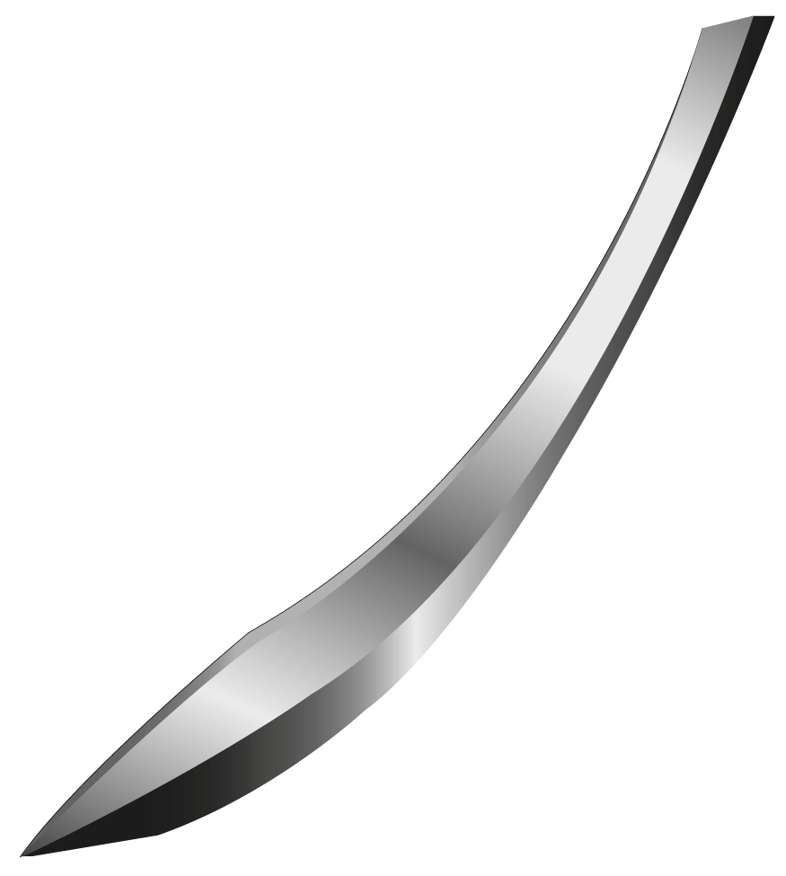
CUTTING NEEDLE ATRAGLIDE “HP” Evolution in geometric design
Design, sharpness and technology with outstanding performance facilitating the penetration and smooth passage through tissue in plastic, cosmetic and reconstructive surgery.
Stylized tip which facilitates penetration maintaining excellent control, narrow diamond shaped tip which facilitates penetration through tissue.
The four (4) elongated cutting axes expand and to facilitate penetration, and subsequently merge again into the body of the needle thus achieving a decrease in tissue trauma.
An excellent choice for plastic, cosmetic and reconstructive surgery.

Slide 8
REVERSE CUTTING NEEDLE SUPRA-SHARP “P-P” CONVENTIONAL CUTTING NEEDLE SUPRA-SHARP “P-Q”
Cutting needle characterized by its triangular cutting pattern, with the cutting edge on the outside of the body of the needle.
Thinner apexes, which gives greater ease of penetration.
An excellent choice for plastic, cosmetic and reconstructive surgery and generally in skin closure where an perfect cosmetic result is desired.
Cutting needle characterized by its triangular cutting pattern, with the cutting edge on the intside of the body of the needle.
Thinner apexes, which gives greater ease of penetration.
An excellent choice for plastic, cosmetic and reconstructive surgery and generally in skin closure where an perfect cosmetic result is desired.

Slide 9
REVERSE CUTTING NEEDLE PREMIUM“P” CONVENTIONAL CUTTING NEEDLE PREMIUM “Q”
Cutting needle characterized by its triangular cutting pattern, with the cutting edge on the outside of the body of the needle.
Cutting needle characterized by its triangular cutting pattern, with the cutting edge on the inside of the body of the needle.

Slide 10
Absorbables Sutures
ATRAMAT | Material | Origin | Manufacture | Coated | Mechanism of absorption | Tensile Strength | Total Absorption | Thread Color | Characteristics
PGA (POLYGLYCOLIC ACID) | Glycolic acid homopolymer | Synthetic | Multifilament Braided | Polycaprolactone and calcium stearate | Hydrolysis | 70% of its original tensile strength by the second week and 50% by the third week. | 60 to 90 days | violet and undyed. | ●Minimal inflammatory reaction in tissue. ●High knot security, handling and realization the knot. ● High tensile strength and excellent tissue support. ●The violet color provides excellent visibility in the surgical field.
PGA RAPID (POLYGLYCOLIC ACID QUICK ABSORPTION) | Low molecular weight of glycolic acid homopolymer. | Synthetic | Multifilament Braided | Polycaprolactone and calcium stearate | Hydrolysis | 50% of its original tensile strength by the first week. | 42 days | Undyed | ●Minimal inflammatory reaction in tissue. ●High knot security, handling and realization the knot. ● High tensile strength and excellent tissue support.
PGLA90 | Copolymer of glycolic acid and L-lactide [poly(glycolide-co-L-lactide). | Synthetic | Multifilament Braided | Poly(glicolide-co-L-lactide) and Calcium Sterearate | Hydrolysis | 75% of its original tensile strength by the second week | 60 to 80 days | violet or beige (undyed). | ●Minimal inflammatory reaction in tissue. ●High knot security, handling and realization the knot. ● High tensile strength and excellent tissue support. ●The violet color provides excellent visibility in the surgical field.
PGLA90 Rapid | Copolymer of glycolic acid and L-lactide [poly(glycolide-co-L-lactide). | Synthetic | Multifilament Braided | Poly(glicolide-co-L-lactide) and Calcium Sterearate | Hydrolysis | 50% of its original tensile strength by the first week. | 42 days | beige (undyed). | ●Minimal inflammatory reaction in tissue. ●High knot security, handling and realization the knot. ● High tensile strength and excellent tissue support. ●The violet color provides excellent visibility in the surgical field.
PDX | Polydioxanone | Synthetic | Monofilament | N/A | Hydrolysis | 70% of its original tensile strength by the fourth week, and 50% by the sixth week | 180 to 220 days | violet | ●Minimal inflammatory reaction in tissue. ●High knot security, handling and realization the knot. ● High tensile strength and excellent tissue support. ●The violet color provides excellent visibility in the surgical field.
PGC25 | coplymer of glycolide and caprolactone [poly (glycolide-co-Epsilon-caprolactone)] | Synthetic | Monofilament | N/A | Hydrolysis | violet: color retains 68% of its original tensile strength by the first week, and 41% by the second week. Undyed: retains 79% of its original tensile strength by the first week, and 40% by the second week. | Violet: 110 days Undyed: 90 days | violet or undyed | ●Minimal inflammatory reaction in tissue. ●High knot security, handling and realization the knot. ● High tensile strength and excellent tissue support. ●The violet color provides excellent visibility in the surgical field.
PDX PLUS | Polydioxanone | Synthetic | Monofilament | N/A | Hydrolysis | 70% of its original tensile strength by the fourth week, and 50% by the sixth week | 180 to 210 days | violet | ●Minimal inflammatory reaction in tissue. ●High knot securiry, handling and realization the knot. ● High tensile strength and excellent tissue support. ●Contains chlorhexidine diacetate, which is a broad spectrum antibacterial agent that inhibits the growth of bacteria such as Staphylococcus aureus, Escherichia coli, microorganisms known to contribute to an infection of a surgical site. ●The violet color provides excellent visibility in the surgical field.
PGC25 PLUS | Poly(glycolide-co-epsilon-caprolactone) surgical suture with antibacterial | Synthetic | Monofilament | Clorhexidine diacetate | Hydrolysis | Violet: 70% of its original tensile strength in the first week and 40% in the second week. | 110 days | violet or undyed | ●Minimal inflammatory reaction in tissue. ●High knot securiry, handling and realization the knot. ● High tensile strength and excellent tissue support. ●Contains chlorhexidine diacetate, which is a broad spectrum antibacterial agent that inhibits the growth of bacteria such as Staphylococcus aureus, Escherichia coli, microorganisms known to contribute to an infection of a surgical site. ●The violet color provides excellent visibility in the surgical field.
PGLA90 PLUS | Polyglactin 910 poly(glycolide-co-Lactide) surgical suture with antibacterial | Synthetic | Multifilament Braided | Poly(glicolide-co-L-lactide) and Calcium Sterearate, clorhexidine diacetate | Hydrolysis | 75% of its original tensile strength in the second week and 46% in the third week. | 56 to 70 days | violet or beige (undyed). | ●Minimal inflammatory reaction in tissue. ●High knot securiry, handling and realization the knot. ● High tensile strength and excellent tissue support. ●Contains chlorhexidine diacetate, which is a broad spectrum antibacterial agent that inhibits the growth of bacteria such as Staphylococcus aureus, Escherichia coli, microorganisms known to contribute to an infection of a surgical site. ●The violet color provides excellent visibility in the surgical field.

Slide 11
Non-absorbables Sutures
ATRAMAT | Material | Origin | Manufacture | Coating | Absorption Mechanism | Tensile strength | Total absorption | Thread Color | Characteristics
Polypropylene | Polypropylene | Synthetic | Monofilament | N/A | N/A | Indefinite | N/A | blue | ● Minimal tissue reaction ● Extruded as filament, computer controlled uniform diameter provides smooth passage through tissue, minimizing tissue drag ● Ideal as a permanent support without compromising its tensile strength ● Biocompatibility, smoothness, plastic deformation, offering a minimal tissue drag, elastic coupling of knot providing excellent security ● Resistance to repeated bending ideal for cardiovascular procedures requiring heart propulsion support either in cardiac prosthesis or vascular anastomosis.
Nylon | Polyamide 6.0 and 6.6 | Synthetic | Monofilament | N/A | N/A | Gradual loss of tensile strength over time | N/A | black, blue, undyed | ● Minimal tissue reaction, high-quality raw materials. ● The thread passes smoothly through tissue, offering a minimal tissue drag ● Allows easy removal of stitches, preventing entrainment of microorganisms.

Slide 12
HP | Type Needle | Needle mm | Curvature | Gauge | Thread Color | Thread length cm
PDX | AtraGlide Cutting | 11-24 mm | 3/8 | 6-0 a 2-0 | Undyed /Violet | 45-75
PGC25 | AtraGlide Cutting | 11-24 mm | 3/8 | 6-0 a 2-0 | Undyed /Violet | 45-70
PGLA90 | AtraGlide Cutting | 11-24 mm | 3/8 | 6-0 a 2-0 | beige(Undyed)/ Violet | 45
PGLA90 Rapid | AtraGlide Cutting | 11-24 mm | 3/8 | 6-0 a 2-0 | beige (Undyed) | 45-75
PGA | AtraGlide Cutting | 11-24 mm | 3/8 | 6-0 a 2-0 | Undyed /Violet | 45
PGA Rapid | AtraGlide Cutting | 11-24 mm | 3/8 | 6-0 a 2-0 | Undyed | 45-75
PGLA90 PLUS | AtraGlide Cutting | 11-24 mm | 3/8 | 5-0 a 2-0 | Undyed/Violet | 45
PGC25 PLUS | AtraGlide Cutting | 11-24 mm | 3/8 | 6-0 a 2-0 | Undyed | 45-70
PDX PLUS | AtraGlide Cutting | 11-24 mm | 3/8 | 6-0 a 2-0 | Violet | 45
Polypropylene | AtraGlide Cutting | 11-24 mm | 3/8 | 6-0 a 2-0 | Blue | 45-75
Nylon | AtraGlide Cutting | 11-24 mm | 3/8 | 6-0 a 2-0 | Black | 45
P-P | Type Needle | Needle mm | Curvature | Gauge | Thread Color | Thread length cm
PDX | Supra Sharp reverse cutting | 11-24 mm | 3/8 | 6-0 a 2-0 | Undyed /Violet | 45
PGC25 | Supra Sharp reverse cutting | 11-24 mm | 3/8 | 6-0 a 2-0 | Undyed /Violet | 45-70
PGLA90 | Supra Sharp reverse cutting | 11-24 mm | 3/8 | 6-0 a 2-0 | Violet /beige(Undyed | 45
PGLA90 Rapid | Supra Sharp reverse cutting | 11-24 mm | 3/8 | 6-0 a 2-0 | beige (Undyed) | 45-75
PGA | Supra Sharp reverse cutting | 11-24 mm | 3/8 | 6-0 a 2-0 | Violet/Undyed | 45
PGA Rapid | Supra Sharp reverse cutting | 11-24 mm | 3/8 | 6-0 a 3-0 | Undyed | 45-75
PGLA90 PLUS | Supra Sharp reverse cutting | 11-24 mm | 3/8 | 5-0 a 2-0 | Undyed/Violet | 45
PGC25 PLUS | Supra Sharp reverse cutting | 11-26 mm | 3/8 | 6-0 a 2-0 | Undyed | 45-70
PDX PLUS | Supra Sharp reverse cutting | 8-26 mm | 3/8 | 6-0 a 2-0 | Violet | 45
Polypropylene | Supra Sharp reverse cutting | 11-24 mm | 3/8 | 6-0 a 2-0 | Blue | 45
Nylon | Supra Sharp reverse cutting | 11-24 mm | 3/8 | 6-0 a 2-0 | Black | 45
** Curvatures and length of the strand other measures upon request.

Slide 13
P-Q | Type Needle | Needle mm | Curvature | Gauge | Thread Color | Length Thread cm
PDX | Supra Sharp conventional cutting | 13-19 mm | 3/8 | 6-0 a 4-0 | Undyed /Violet | 45
PGC25 | Supra Sharp conventional cutting | 11-24 mm | 3/8 | 6-0 a 2-0 | Undyed /Violet | 45-70
PGLA90 | Supra Sharp conventional cutting | 13-24 mm | 3/8 | 6-0 a 2-0 | Violet /beige(Undyed) | 45
PGLA90 Rapid | Supra Sharp conventional cutting | 16-24 mm | 1/2, 3/8 | 4-0 a 3-0 | beige (Undyed) | 45-75
PGA | Supra Sharp conventional cutting | 13-24 mm | 3/8 | 6-0 a 2-0 | Violet /Undyed | 45
PGA Rapid | Supra Sharp conventional cutting | 16-24 mm | 1/2, 3/8 | 4-0 a 3-0 | Undyed | 45-75
PGLA90 PLUS | Supra Sharp conventional cutting | 16-36 mm | 3/8 | 5-0 a 2-0 | Undyed /Violet | 45-70
PGC25 PLUS | Supra Sharp conventional cutting | 13-19 mm | 3/8 | 5-0 a 4-0 | Undyed/Violet | 45
PDX PLUS | Supra Sharp conventional cutting | 13-26 mm | 3/8 | 6-0 a 3-0 | Violet | 45-70
Polypropylene | Supra Sharp conventional cutting | 16-19 mm | 3/8 | 6-0 a 3-0 | Blue | 45
Nylon | Supra Sharp conventional cutting | 16-19mm | 3/8 | 6-0 a 4-0 | Black | 45
P | Type Needle | Needle mm | Curvature | Gauge | Thread Color | Length Thread cm
PDX | Premium reverse cutting | 13-24 mm | 3/8 | 6-0 a 2-0 | Undyed /violet | 45
PGC25 | Premium reverse cutting | 13-24 mm | 3/8 | 6-0 a 2-0 | Undyed /violet | 45-70
PGLA90 | Premium reverse cutting | 13-24 mm | 3/8 | 6-0 a 3-0 | Violet /beige(Undyed) | 45
PGLA90 Rapid | Premium reverse cutting | 13-24 mm | 3/8 | 5-0 a 3-0 | beige (Undyed) | 45-75
PGA | Premium reverse cutting | 11-24 mm | 3/8 | 6-0 a 2-0 | Violet /Undyed | 45-75
PGA Rapid | Premium reverse cutting | 16-24 mm | 3/8 | 5-0 a 2-0 | Undyed | 45-75
PGLA90 PLUS | Premium reverse cutting | 11-48 mm | 3/8, 1/2 | 5-0 a 2 | Undyed/Violet | 70-90
PGC25 PLUS | Premium reverse cutting | 13-40 mm | 3/8, 1/2 | 6-0 a 1 | Undyed | 70-90
PDX PLUS | Premium reverse cutting | 13-48 mm | 3/8, 1/2 | 6-0 a 1 | Violet | 45-90
Polypropylene | Premium reverse cutting | 13-24 mm | 3/8 | 6-0 a 3-0 | Blue | 45
Nylon | Premium reverse cutting | 11-24 mm | 3/8 | 6-0 a 3-0 | Black | 45
** Curvatures and length of the strand other measures upon request.

Slide 14
PU | Type Needle | Needle mm | Gauge | Thread Color | Length Thread cm
PGC25 | Premium cutting | 60 mm | 3-0 | Undyed/violet | 70
PGLA90 | Premium cutting | 60 mm | 4-0 a 2-0 | Violet /beige(Undyed) | 70
PGLA90 Rapid | Premium cutting | 60 mm | 3-0 a 2-0 | beige (Undyed) | 70
PGA | Premium cutting | 60 mm | 4-0 a 2-0 | Violet / Undyed | 70
PGA Rapid | Premium cutting | 60 mm | 3-0 a 2-0 | Undyed | 70
PGLA90 PLUS | Premium cutting | 60 mm | 4-0 a 2-0 | Undyed / violet | 70
PGC25 PLUS | Premium cutting | 60 mm | 4-0 a 2-0 | Undyed | 70
PDX PLUS | Premium cutting | 60 mm | 4-0 a 2-0 | violet | 70
Polypropylene | Premium cutting | 60 mm | 4-0 a 2-0 | Blue | 75
Nylon | Premium cutting | 60 mm | 4-0 a 0 | Black | 75
** Curvatures and length of the strand other measures upon request.

Slide 15
https://stock.adobe.com/mx/search?k=74891738&show_images=1&filters%5Bcontent_type%3Avideo%5D=1&color=
https://stock.adobe.com/mx/search?k=101930762&show_images=1&filters%5Bcontent_type%3Avideo%5D=1&color=
https://stock.adobe.com/mx/search?k=101935727&show_images=1&filters%5Bcontent_type%3Avideo%5D=1&color=
https://stock.adobe.com/mx/search?k=101935727&show_images=1&filters%5Bcontent_type%3Avideo%5D=1&color=
https://stock.adobe.com/mx/search?k=88828101&show_images=1&filters%5Bcontent_type%3Avideo%5D=1&color=
https://stock.adobe.com/mx/search?k=96935862&show_images=1&filters%5Bcontent_type%3Avideo%5D=1&color=

